Slide 1
Machine Learning (Course) : Ride rating prediction
By Sharon Christina
Supervised by Mr. Anil Jadon

Slide 2
Overview
Introduction
Objective
Variable Description
Descriptives
Exploratory Analysis
Correlation Tables
Outlier Detection and Treatment
Analysis
Bivariate Analysis
Random Forest Classifier
Method Validation
References

Slide 3
Introduction
Customer Data
Ride Based Data
Rating
Customer Preferences → Insights on Improving Overall Business
XXXX TAXI company has provided a random dataset of 9000 rides

Slide 4
Objective
Based on ride related features predict whether customers -
Do they like speedy rides etc.?
Do they estimate prices for long distances?

Slide 5
Variable Description
Variable Name | Description
customer_id | Unique customer identifier. If a customer took more than one trip within 30 days, there will be more than one entry with the Customer ID
driver_id | Unique driver identificator. If a driver made more than one trip within 30 days, there MAY be more than one entry with the driver’s id. But be careful, we filtered the data by the customers, not drivers, so a drive may have a ride that’s not shown in the dataset
creation_date | Date and time when the customer booked the ride
booking_source | The application type via which the customer booked the trip. It can be Android/IOS App, web/mobile web, etc.
car_type | Type of the car used in the trip. There are different prices and service provided by the different car type. It can be economical, luxury, minivan, etc.
estimated_distance | Estimated distance between pick-up and drop-off location according to our algorithms. Can be empty, if the customer didn’t put the drop-off location in the app. Measured in kilometers
distance_travelled | Real trip distance calculated after the trip finished. Measured in kilometers
distance_travelled_while_moving | Distance driven when the car was running fast enough (eg. Not stuck in a traffic)
estimated_duration | The number of minutes that we predict the trip will take. Can be empty, if the customer didn’t put the drop-off location in the app
duration_time | The number of minutes that the trip really took
wait_time_initial | The number of minutes between the driver arrives to the pick-up location and customer gets into the car
wait_time_in_journey | The number of minutes during the trip when the car’s speed was extremely slow (eg stuck in a traffic)
estimated_price | Price that our algorithms predict. Can be empty, if the customer didn’t put the drop-off location in the app
price | Real trip price calculated after the trip completed
is_cancelled | Shows if the trip was cancelled ('0' not cancelled; '1' cancelled)
Rating | 1-5 stars the customer rated the trip. 0 is when there is no data, 1 is a minimal rating 5 is a maximal one
was_rated | Shows if the customer rated the trip ( '0' not rated; '1' rated)
speed | distance_travelled/duration_time (defined for the purpose of study)

Slide 6
Descriptives
 | Booking Source | Car Type | Estimated Distance | Distance | Distance Moving | Estimated Duration | Duration | Wait Initial | Wait Journey | Estimated Price | Price | Cancelled | Rating | Rated? | Speed
COUNT | 51083 | 51083 | 51083 | 51083 | 51083 | 51083 | 51083 | 51083 | 51083 | 51083 | 51083 | 51083 | 51083 | 51083 | 51083
MEAN | 1.51 | 1.11 | 0.58 | 6.33 | 5.80 | 1.51 | 15.49 | 2.36 | 5.44 | 1.36 | 13.51 | 0.04 | 3.26 | 0.68 | 0.42
STD | 0.51 | 0.45 | 1.71 | 4.15 | 3.96 | 4.38 | 9.42 | 2.51 | 5.19 | 3.80 | 3.97 | 0.20 | 2.30 | 0.47 | 0.17
MIN | 1 | 1 | 0 | 0.69 | 0.51 | 0 | 3 | 0 | 0 | 0 | 8.51 | 0 | 0 | 0 | 0.02
25% | 1 | 1 | 0 | 3.20 | 2.82 | 0 | 8 | 0 | 2 | 0 | 10.86 | 0 | 0 | 0 | 0.31
50% | 2 | 1 | 0 | 5.36 | 4.85 | 0 | 13 | 2 | 4 | 0 | 12.68 | 0 | 5 | 1 | 0.40
75% | 2 | 1 | 0 | 8.57 | 7.92 | 0 | 21 | 3 | 8 | 0 | 16.29 | 0 | 5 | 1 | 0.50
MAX | 4 | 6 | 6.55 | 16.26 | 15.34 | 16 | 38 | 9 | 19 | 13.36 | 21.84 | 1 | 5 | 1 | 5.42

Slide 7
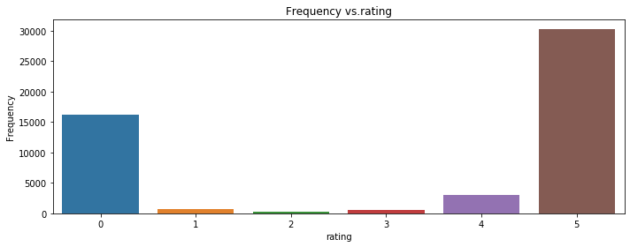
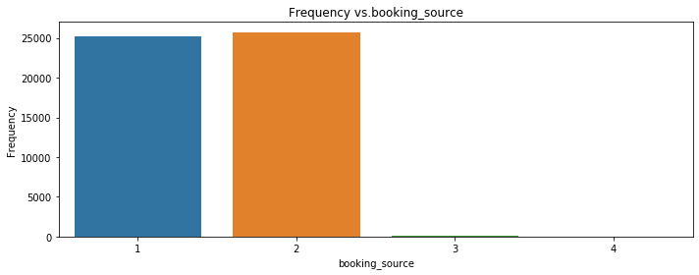
Exploratory Analysis
Feature | Count
Total Variables | 51083
Car Type
1 | 47931
2 | 643
3 | 2485
4 | 22
5 | 1
6 | 1
Booking Source
1 | 25728
2 | 25203
3 | 141
4 | 11
Rating
0 | 16206
1 | 706
2 | 211
3 | 576
4 | 3086
5 | 30298

Slide 8
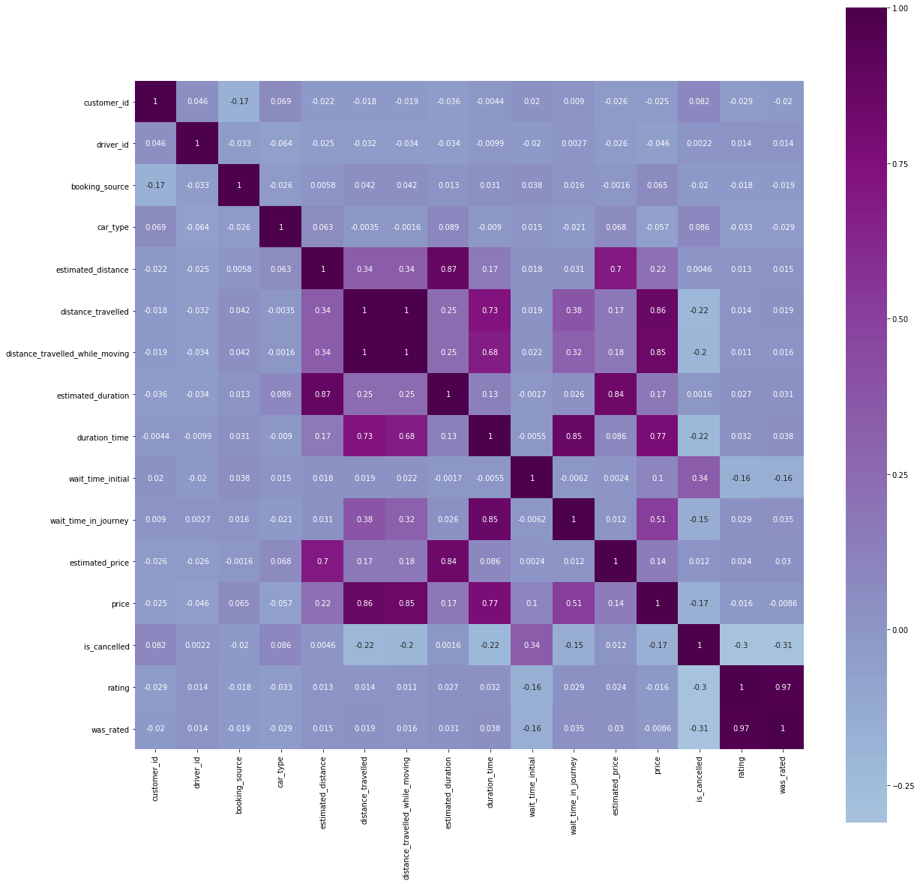
Correlation Table

Slide 9
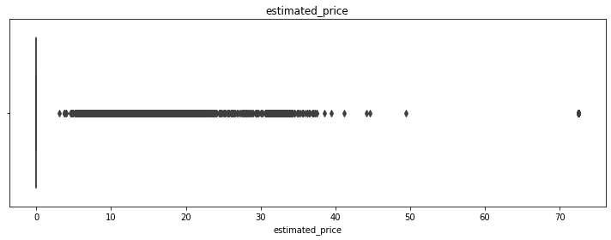
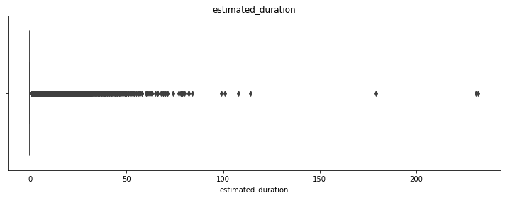
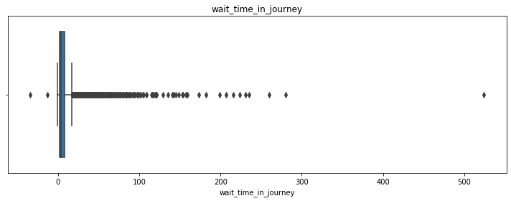
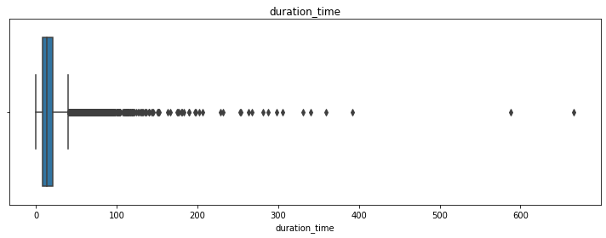
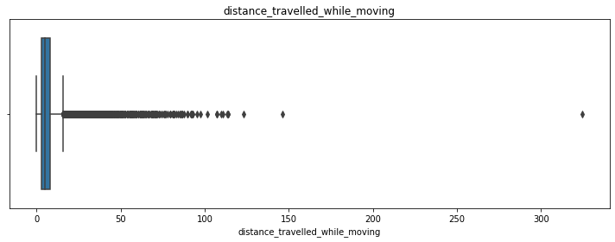
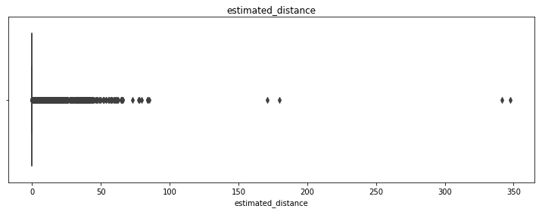
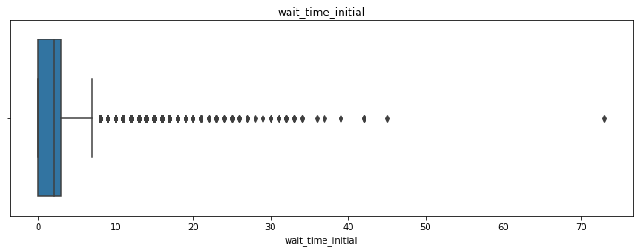

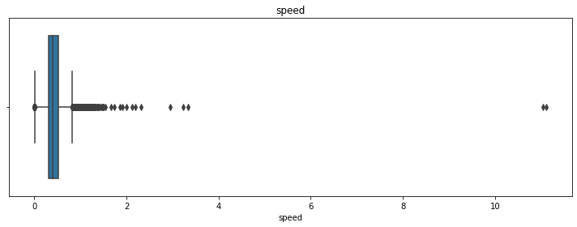
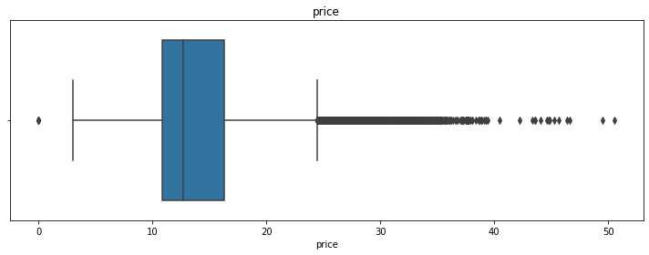
Outlier Detection

Slide 10
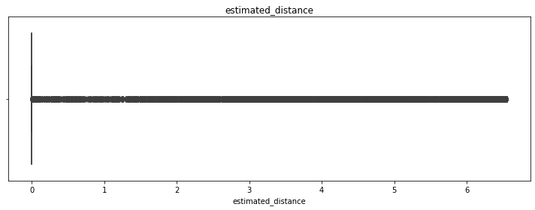
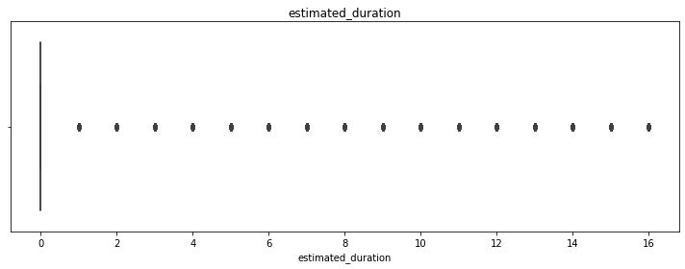
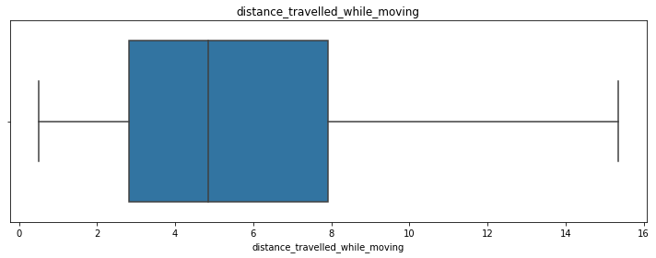
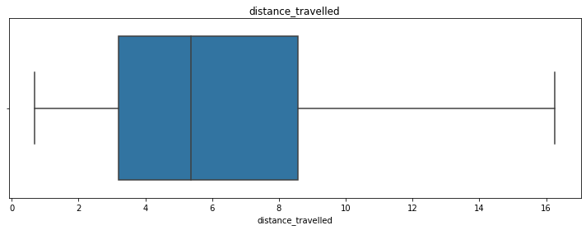
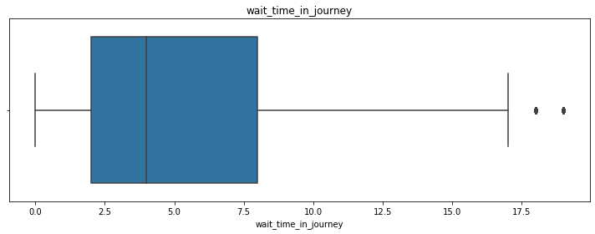
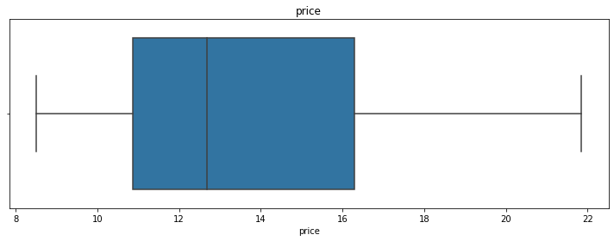
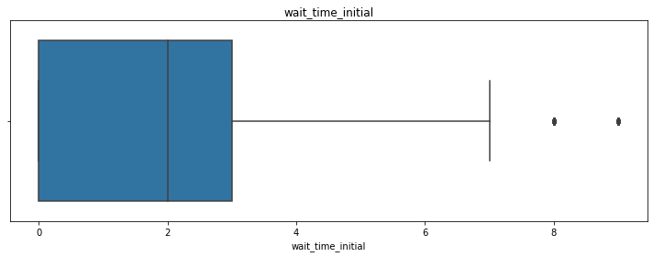
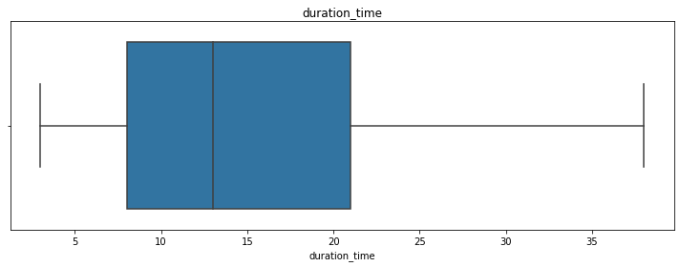
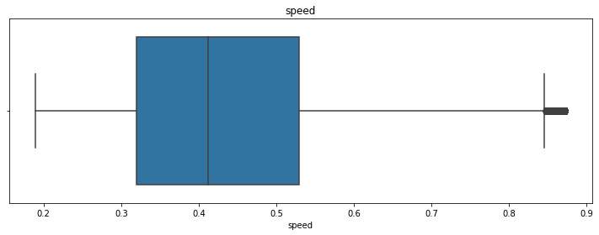
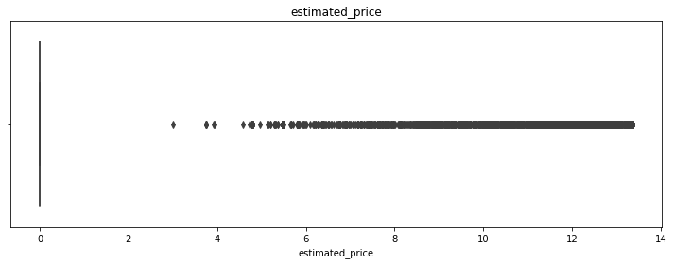
Outlier Treatment post-winsorization at 95%

Slide 11
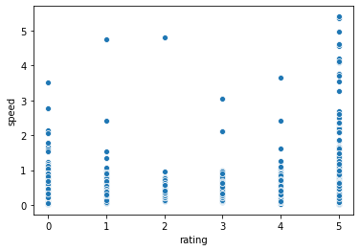
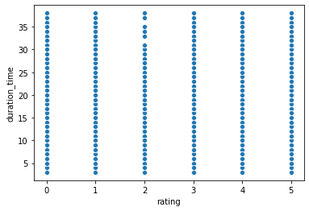
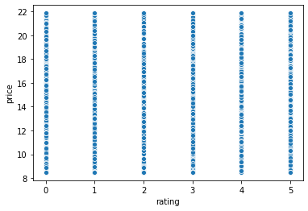


Speed vs. Rating
From the graph of speed vs. rating, we observe that higher speeds correspond to improved ratings (indicated by red circle)
Few exceptions i.e. high speed but with low ratings are highlighted in yellow
No apparent relationship between price and ratings either (refer graph below)
No apparent relationship observed between shorter/ longer rides and ratings

Slide 12
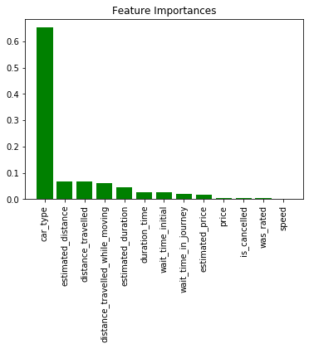
CLASSIFICATION REPORT
RATING | PRECISION | RECALL | f1 SCORE | SUPPORT
0 | 1 | 1 | 1 | 4879
1 | 0.06 | 0.06 | 0.06 | 238
2 | 0 | 0 | 0 | 61
3 | 0.03 | 0.03 | 0.03 | 190
4 | 0.09 | 0.1 | 0.1 | 930
5 | 0.87 | 0.85 | 0.86 | 9027
Accuracy |  | 0.83
Macro Avg | 0.34 | 0.34 | 0.34
Weight Avg | 0.84 | 0.83 | 0.83 | 15325

